Slide 1

Modals of Preference

Slide 2
Modals of Preference
Prefer and would prefer are used to talk about preferences, to express that we like certain things better than others.
I prefer coffee for breakfast.
Would you like to have a seat? - No, I prefer to stand.

Slide 3
Prefer and would prefer can be followed by a noun:
- Would you like to have a cup of tea? -Thanks, but I’d prefer coffee.
Prefer and would prefer can also be followed by the gerund:
When I don’t have time to go out shopping, I prefer doing it online.
Prefer and would prefer can also be followed by the infinitive:
They prefer to study in the morning.

Slide 4
Would rather is also used to make suggestions and express preferences:
I’m so tired, I’d rather stay at home.
The negative form is would rather not:
A: Maybe you can ask him for help.
B: I’d rather not. I prefer to do the project by myself.
To ask questions we can use would or do with prefer and rather:
Would you rather sit down?
Would you prefer to sit down?
Do you prefer (to) / rather sit down?

Slide 5

MODALS OF PERMISSION

Slide 6
Modals of Permission
May, Could and Can are modal verbs used to ask for permission. May is the most polite, and can is the least formal:
May I have another piece of cake?
Could I bring a friend to your party?
Can I play some music at your party?

Slide 7
Remember we often use “please” to ask for permission in a more polite way. The word “please” can go before the verb or at the end of the question:
May I please speak to you for a moment?
May I speak to you for a moment, please?

Slide 8
We usually answer questions about permission with the following expressions:
Yes, sure.
Sure.
Certainly.
Of course.
Go ahead.
We can also use may and can in short answers about permission, but we never use could.

Slide 9
The expression “Do you mind…” is also used to ask for permission. It is followed by if + a sentence:
Do you mind if I use your cell phone to call my brother?
To answer to this expression we need negative responses.
Do you mind if I look at that file? – Not at all (=it’s OK, you can do it).
This expression is very formal, so we don’t use “please” with it.

Slide 10
When we say no to a question about permission, we usually apologize and give a reason:
A: Can you come to my office on Tuesday?
B: No, I can’t. I’m sorry but I’m busy on Tuesday.
A: Could you help me with the English homework?
B: I’m sorry but I don’t understand this exercise either.

Slide 11
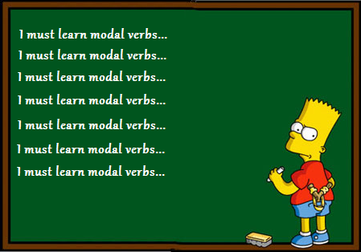
MODALS OF OBLIGATION AND NECESSITY

Slide 12
Modals of Obligation and Necessity
These modals are used to show strong obligation or necessity.
Must is used in formal situations, it expresses very strong obligation, usually there is not an option.
You must study for the next exam.
Must not is used to indicate prohibition.
You mustn’t exceed the speed limit!

Slide 13
Have to is the most common way of expressing necessity or obligation, it can be used in all situations.
We have to start now. (present tense)
We had to do a lot of homework yesterday. (past tense)
We will have to finish the project next week. (future tense)
Have got to is only used in informal situations. In the negative form use don’t have to instead of haven’t got to, we can’t use have got to in questions.

Slide 14
Don’t have to, don’t need to and needn’t
These modals are used to show lack of necessity or obligation, that is, it is not necessary to do something.
I don’t have to get up early today, I’m on holiday.
The doctor told me: “You needn’t / don’t have to / don’t need to stay in bed but don’t go out”.

Slide 15


Slide 16
Preference: “(would) prefer”, “would rather”:
http://www.ompersonal.com.ar/ADVANCED/unit1/page7.htm
http://www.ompersonal.com.ar/ADVANCED/unit1/page8.htm
Permission: “can, “may”, “could”, “Do you mind/Is it ok if I …?”
http://usefulenglish.ru/grammar/modal-verbs-exercise-four
Offer: “Can I help you?”, “Do you need help?”, “Let me help you”.
http://www.montsemorales.com/gramatica/OffersReq.htm
Necessity / Obligation: “have to”, “must”, “need to”.
http://www.ompersonal.com.ar/omgrammar/verbosmodales1.htm
http://www.ompersonal.com.ar/INTERMEDIATE/unit6/page5.htm
http://www.ompersonal.com.ar/INTERMEDIATE/unit6/page6.htm (Reading Comprehension)

